Slide 1
Using Twitter to Track Chikungunya in Puerto Rico
Wesley Chen, Feb 2015

Slide 2




Twitter as a Self-Reporting Medium

Slide 3
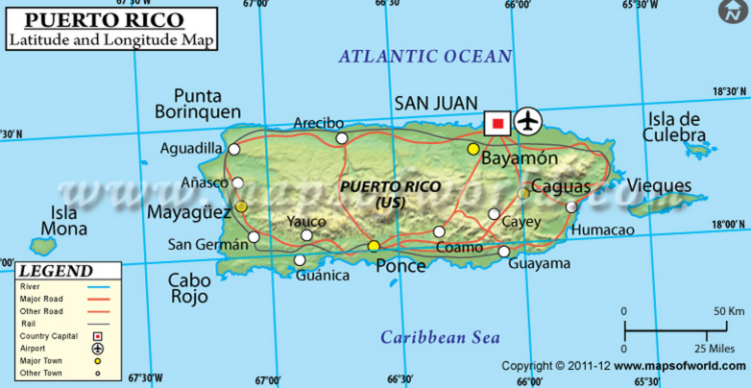
Looking for What We Want
\b[keyword]\b
Geo-Tagged
Tweet or Profile
Keywords:
Chikungunya/Chikv
Symptoms (rash, vomit, fever, joint pain)
Jan. 5 2014 – Present (Jan. 16, 2015)

Slide 4
Some Quick Numbers and Thoughts
1452 hits of 10 million (0.01%)
80% unique users
Peak 3 weeks 194, 149, 112
15, 15, 14 rash
28, 16, 16 dengue
Gold Standard: PAHO/WHO Data
Suspected Cases?
Time Lag?

Slide 5
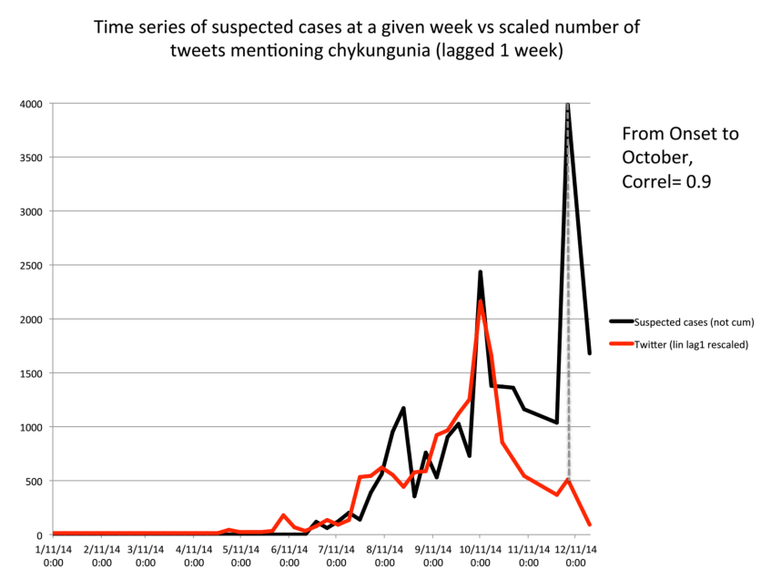
Looking More Into the Data

Slide 6
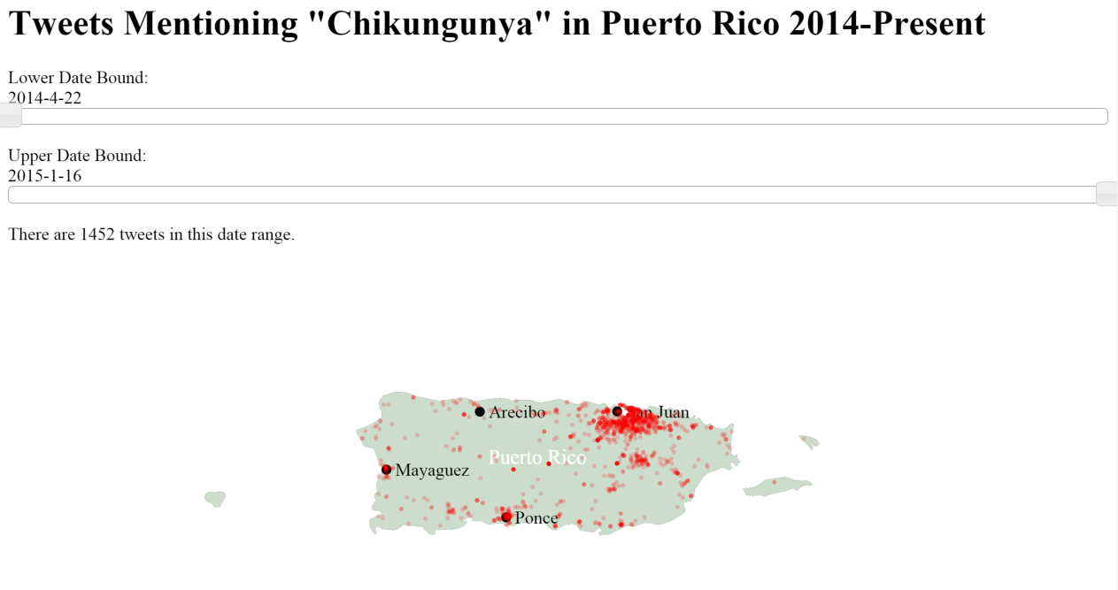
Visualization: Where are our Tweets?

Slide 7
Curation: What Do the Tweets Say?
Sample around 1500 so avoided NLP
250 self eporting
140 reporting others
80 showing symptoms
147 news/awareness
275 “jokes”
Chikungunya songs, reporting not having it, debates

Slide 8
Current/Next Steps
Use a multivariate regression (LASSO)
Dynamic predictive model
How well can we predict the PAHO/WHO numbers?

Slide 9
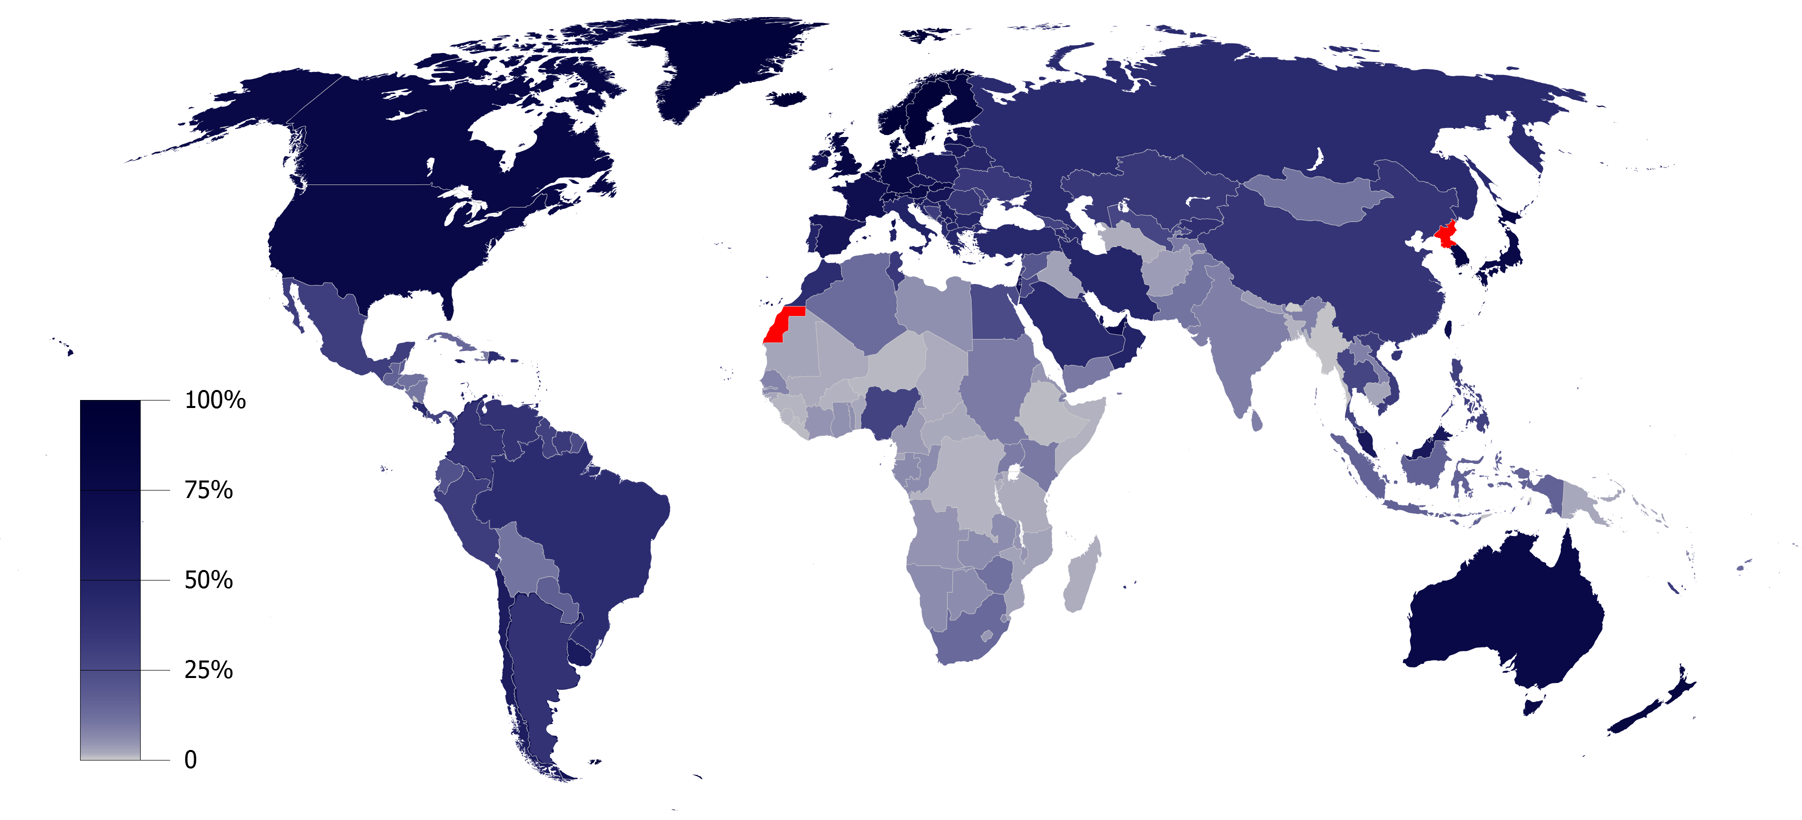
Extending the Concept
Internet Penetration/Twitter
Set of keywords
Self-Reported

